Slide 1
MOT1421: Economic Foundations Week 2: structure-conduct-performance (SCP)
Market structures:
PERFECT COMPETITION
MONOPOLY model assumptions
OLIGOPOLY

Slide 2
MOT1421: Economic Foundations Week 2: structure-conduct-performance
 | perfect competition | oligopoly | monopoly
Structure | Large numbers of buyers and sellers; no market concentration | A few suppliers and a large number of buyers. Supply is concentrated in a few firms. | One seller/supplier and a large number of buyers. Supply is concentrated in one firm.
 | Firms do not have market power; firms are price-takers. | Firms have market power, but have to reckon with what other firms do (strategic inter-dependence); firms either decide the quantity of output or the price. | The monopolistic firm is a price-setter or determines the quantity of output; the firm has market power.
 | All firms use the same technology; cost functions are identical across firms. | Firms may use the same or different technologies; cost functions may be similar or different. | The monopolistic firm uses a given technology and has given cost functions.
 | All firms produce identical goods. There is no product differentiation. | In some oligopolistic markets, firms produce identical goods, but in other markets, firms produce differentiated goods. | The monopolistic firm produces one specific good/service. The monopolist can engage in product differentiation.
 | Entry into and exit from this market are free and costless. | Entry into and exit from these markets may be free and costless, but incumbent firms may deter or block potential entrants. | Entry into the market is blocked – by law, license or by the action of the incumbent firm.
 | All market actors have perfect information; the market is transparent. | All market actors have perfect information; the market is transparent. | All market actors have perfect information; the market is transparent.
Conduct | Firms aim for maximum profits | Firms aim for maximum profits | The firm aims for maximum profits
Performance | In long-run equilibrium, the market price = average cost; firms only have normal profits. | In general, the market price will exceed average cost and firms make super-normal profits (but smaller than those in monopoly). | In equilibrium, the market price will normally be higher than average cost; firms make super-normal profits.
 | Consumers therefore pay the lowest possible price – and consumer welfare is highest. | Consumers pay more than in perfect competition, but less than in monopoly. | Consumers therefore pay a high price – and consumer welfare is lowest.

Slide 3
MOT1421: Economic Foundations Week 2: Perfect Competition
Assumptions:
Large number of buyers and sellers
No firm has market power; all firms are price-takers
Identical (homogenous) products; no product differentiation
Identical firms using the same technology; TC, AC and MC are the same
Free entry/exit; perfect information
Firms are assumed to maximise profits

Slide 4
MOT1421: Economic Foundations Week 2: Perfect Competition
Profit maximisation by the representative (price-taking) firm
Profits = Π(q) = TR(q) – TC(q)
Total Revenue = TR(q) = P*q , where P = given to the firm; note that dTR/dq = MR = P
Total Cost = TC(q) , i.e. TC are a function of the level of output q
The (first-order) condition for maximum profits = dΠ/dq = 0
→ dTR/dq – dTC/dq = 0 → dTR/dq = dTC/dq → MR = MC
Thus: the firm maximises Π by producing at the profit-maximising level of output q*
at which marginal revenue = marginal cost

Slide 5
MOT1421: Economic Foundations Week 2: Perfect Competition
Determining the (market) equilibrium price in a market of perfect competition: a numerical example
Aggregate market demand for good XYZ is given by: Qd = 400 – 3 × P.
Aggregate market supply is given by: Qs = 100 + 2 × P.
Market equilibrium: Qd = Qs
Hence: 400 – 3 × P = 100 + 2 × P which gives: P* = 60 -> MRi = 60

Slide 6
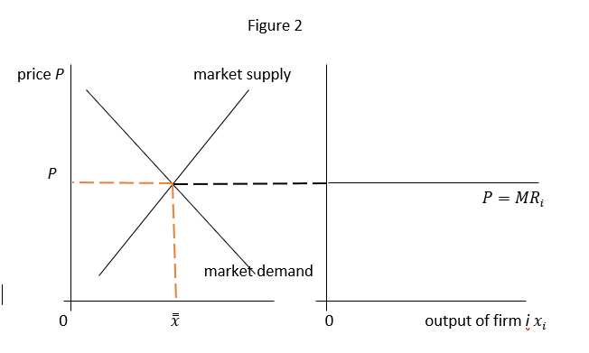
MOT1421: Economic Foundations Perfect Competition: the aggregate market versus the individual firm
The small
firm is a price-
taker, meaning
the price is
given to the
individual
firm.

Slide 7
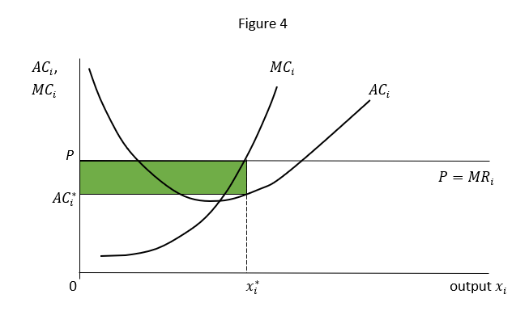
MOT1421: Economic Foundations Perfect Competition: short run P = MC > AC
Total Cost TC_{i} = f(x_{i})
Average cost AC_{i} = TC_{i}/x_{i}
Marginal cost MC_{i}
= dTC_{i}/dx_{i}

Slide 8
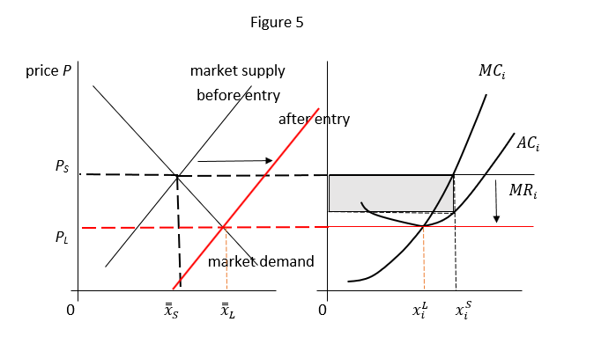
MOT1421: Economic Foundations Perfect Competition: long run P = MC = AC

Slide 9
MOT1421: Economic Foundations Week 2: Perfect Competition
Firms are price-takers and quantity-setters.
Profits (definition):
Π(q) = TR(q) – TC(q) = P*q – AC*q = (P – AC)*q
Short run:
Supernormal profits (P = MC > AC) are possible; it is also possible that
P = MC < AC, which means that firms have below-normal profits.
Long run:
Due to entry/exit, long-run equilibrium is: P = MC = AC. Firms have only normal profits (i.e. Get a normal rate of return).

Slide 10
MOT1421: Economic Foundations Week 2: Market failures
Information problems: asymmetric information
Market instability: expectations, cobwebs, and speculation
Market power: the market is concentrated and a few firms have price-setting power (oligopoly; monopoly)
Externalities: the unpaid-for (or uncompensated) effects of the production of goods and services on persons other than those who are producing and selling these goods and those who are directly buying or using the goods in question
Public goods: (1) non-exclusive; and (2) non-rival

Slide 11
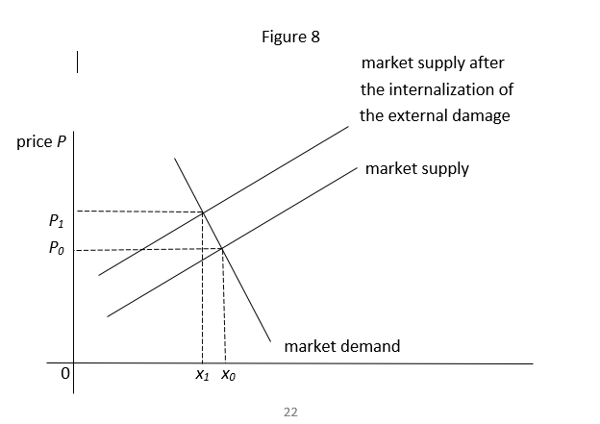
MOT1421: Economic Foundations Week 2: Negative externality
In case of a negative
externality, the private
MC of production do
not include the external
cost. The social (“true”)
marginal cost of production
are higher than the private
MC.

Slide 12
MOT1421: Economic Foundations Week 2: Exercise 1
First, we calculate the market price by assuming that market demand and market supply are equal.
Qd = 400 – 3P = Qs = 100 + 2P → P = 60 = MR for each price-taking firm
Second, we derive MC from TC = 278 + 12q + 2q^2 . Differentiating TC w.r.t. q gives: MC = 12 + 4q.
Third, the condition for maximum profits is MR = MC →
60 = 12 + 4q → q* = 12 (x 1000) = profit-maximising level of output
AC = TC/q* = 59.2 ; hence P > AC (supernormal profits)

